Slide 1

Props, State and Context

Slide 2
Objectives
Passing Property Values
Stateless Components
Container Components
Providing and Consuming Context

Slide 3
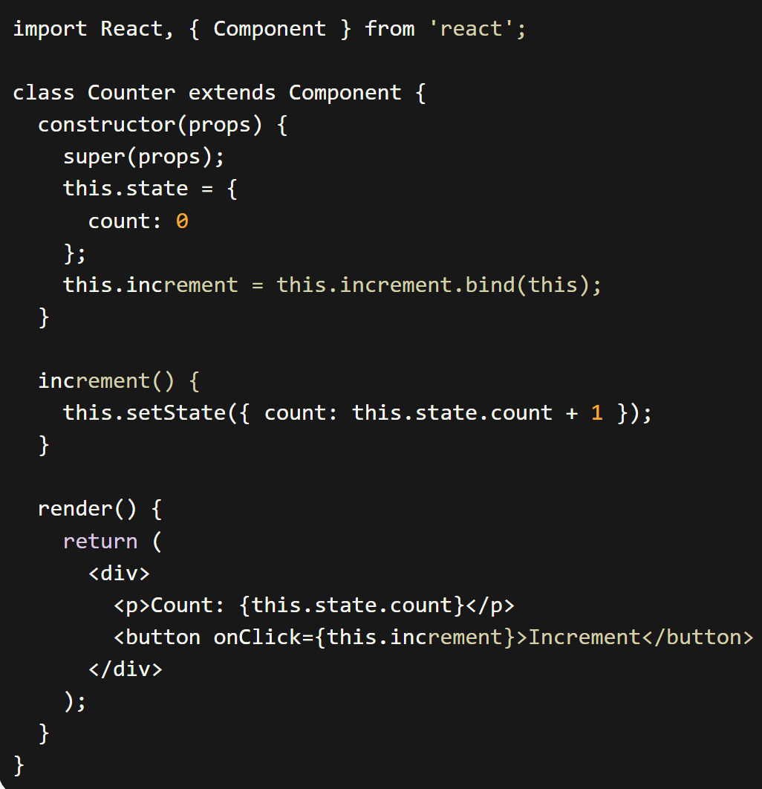
State in Class Components
State declared within the constructor
State should only be modified using setState()
Never do the following:
this.state.count = this.state.count +1 ;

Slide 4
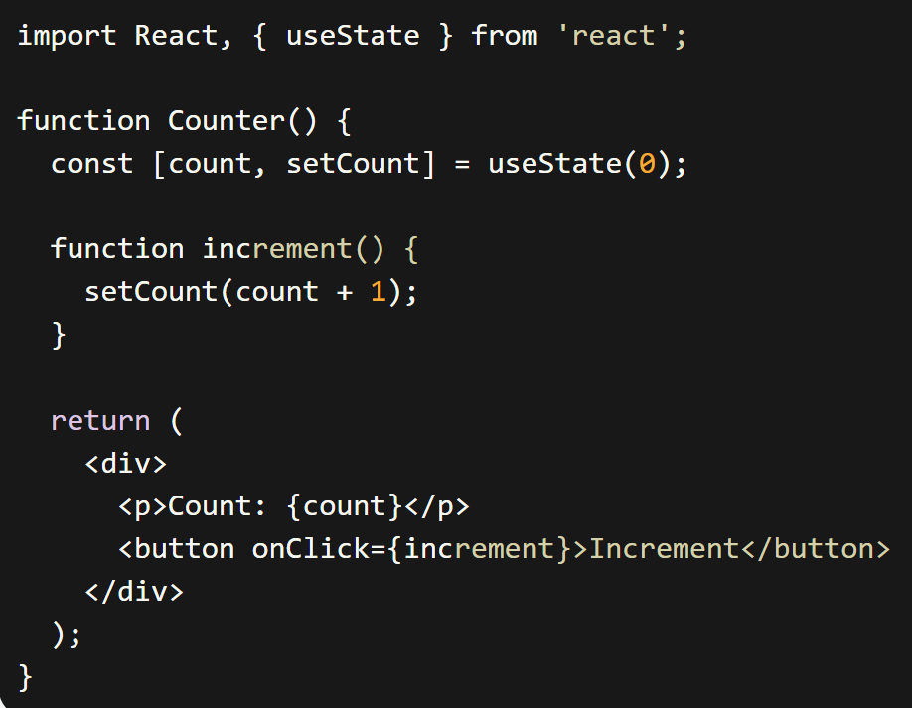
State in Function component
useState() allows you to use state in functional components
import React, { useState } from 'react’;

Slide 5
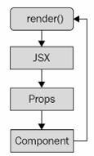
What are component Properties(Props)?
Properties are used to pass data into your React components
In the context of JSX, properties are called attributes
Properties are different than state because they don't change after the initial render of the component.
If a property value has changed, to re-render the component, then we have to re-render the JSX that was used to render it in the first place. The React internals make sure that this is done efficiently.
The cycle of rendering components as properties

Slide 6
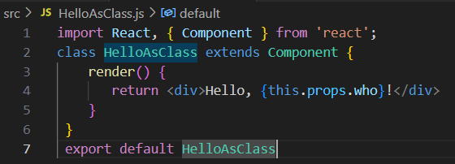
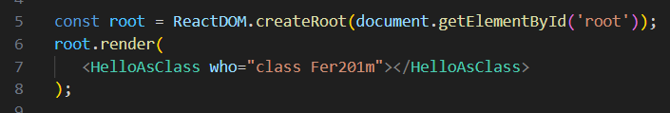

Props with Class Component
Define a class component.
Use the component and pass props to it

Slide 7
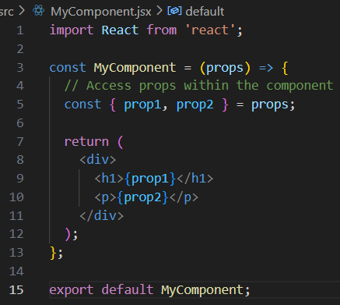
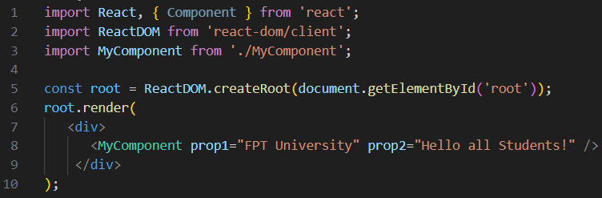

Props with Functional Component
Define a functional component
Use the component and pass props to it

Slide 8
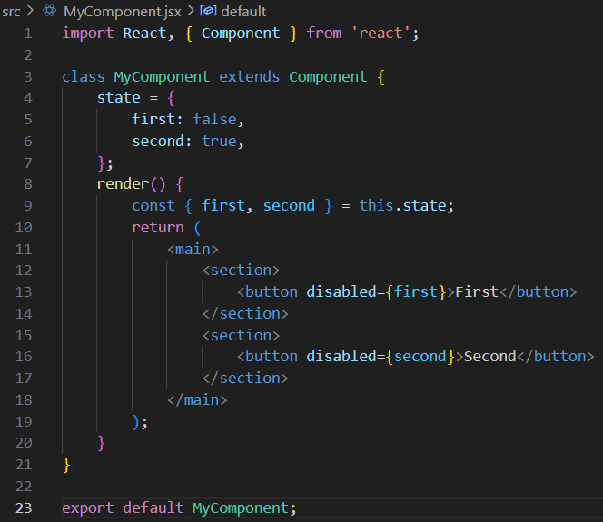
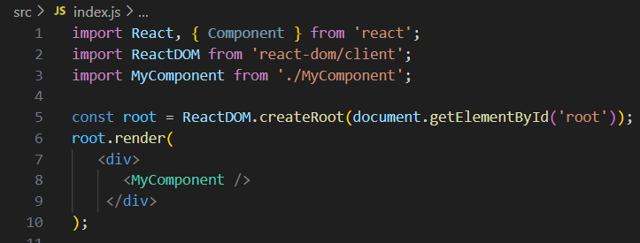
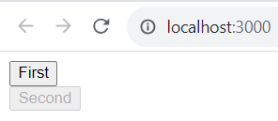
Setting component state
Setting initial component state
Rendering two buttons

Slide 9
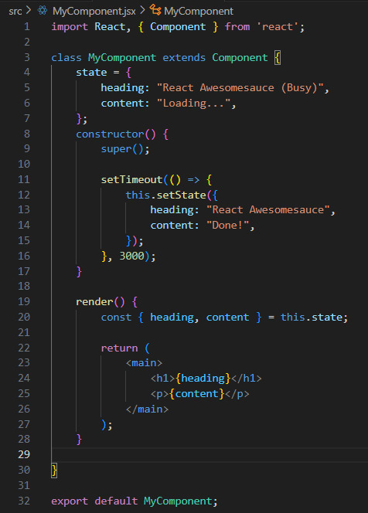
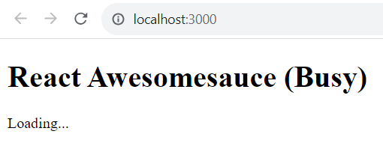
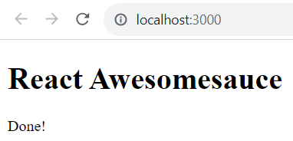
Setting component state – cont’d
Creating component state
The UI while loading
The UI when loading is complete

Slide 10
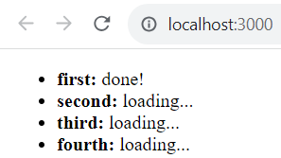
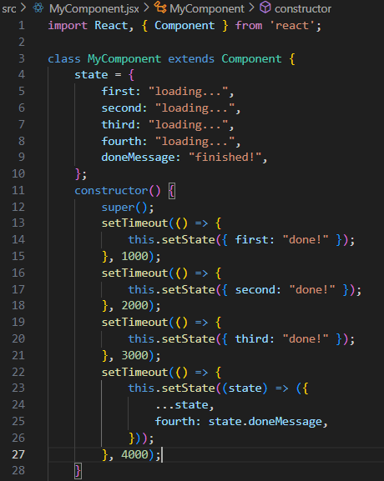
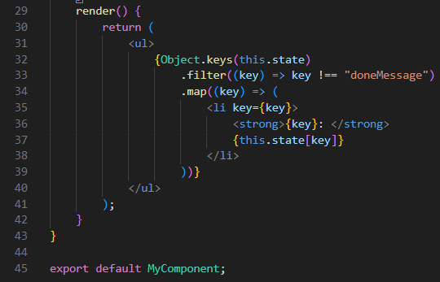
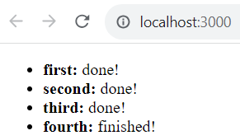
Setting component state – cont’d
Merging component state
The UI while data is loading
The UI when all async
operations are complete

Slide 11
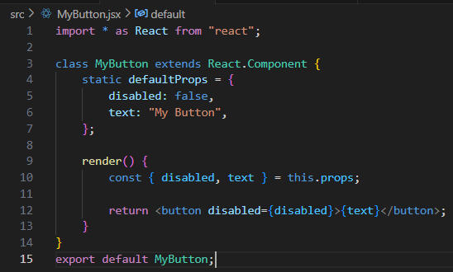
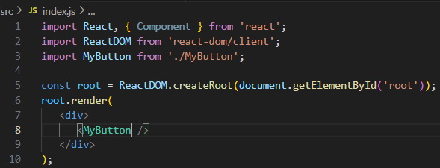
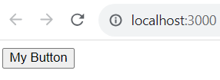
Passing property values
Default property values (defaultProps)
Notes:
Default property values work a little differently than default state values. They're set as a class attribute called defaultProps

Slide 12
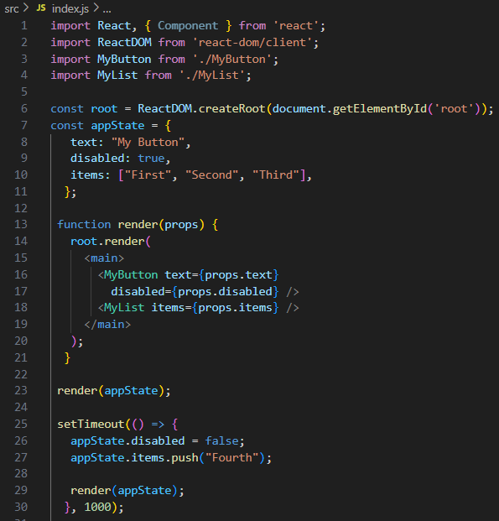
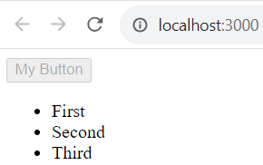
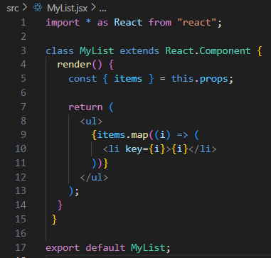
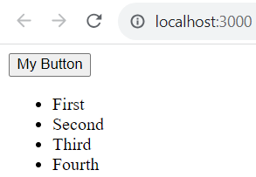
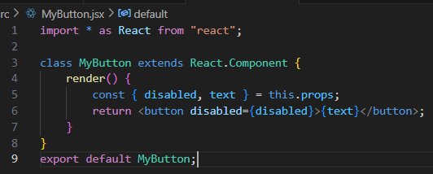
Passing property values – cont’d
Setting property values

Slide 13
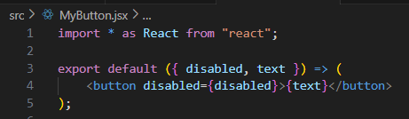
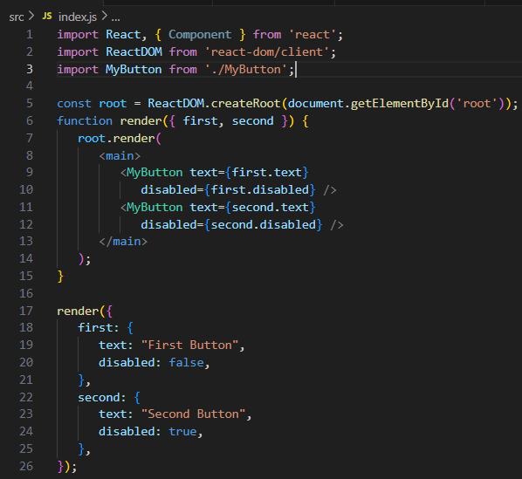
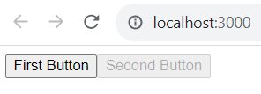
Stateless components
Pure functional components

Slide 14
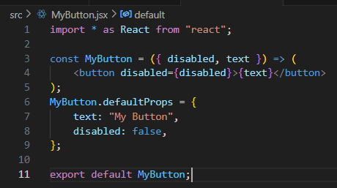
Stateless components – cont’d
Defaults in functional components
Notes:
Functional components are lightweight; they don't have any state or lifecycle

Slide 15
Container components
Don't couple data fetching with the component that renders the data.
The container is responsible for fetching the data and passing it to its child component.
It contains the component responsible for rendering the data.
For example, a container could substitute its child component. Or a child component could be used in a different container.

Slide 16
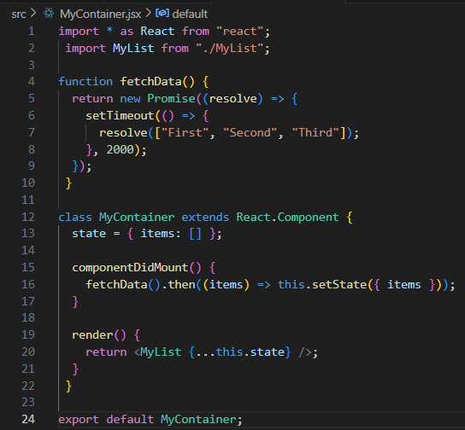
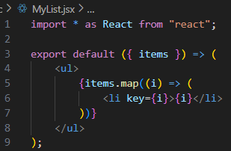
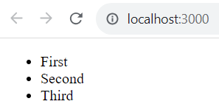
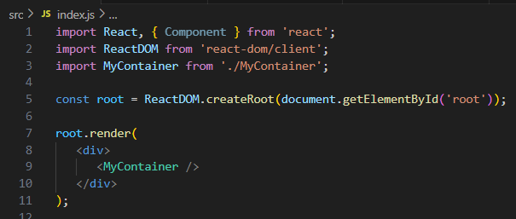
Container components – cont’d

Slide 17
Providing and consuming context – cont’d
In React, when using contexts: providers and consumers.
A context provider creates data and makes sure that it's available to any React components.
A context consumer is a component that uses this data within the context.
Let's say that you have some application data that determines permissions for given application features. This data could be fetched from an API, or it could be hardcoded. In either case, the requirement is that you don't want to have to pass all of this permission data through the component tree.

Slide 18
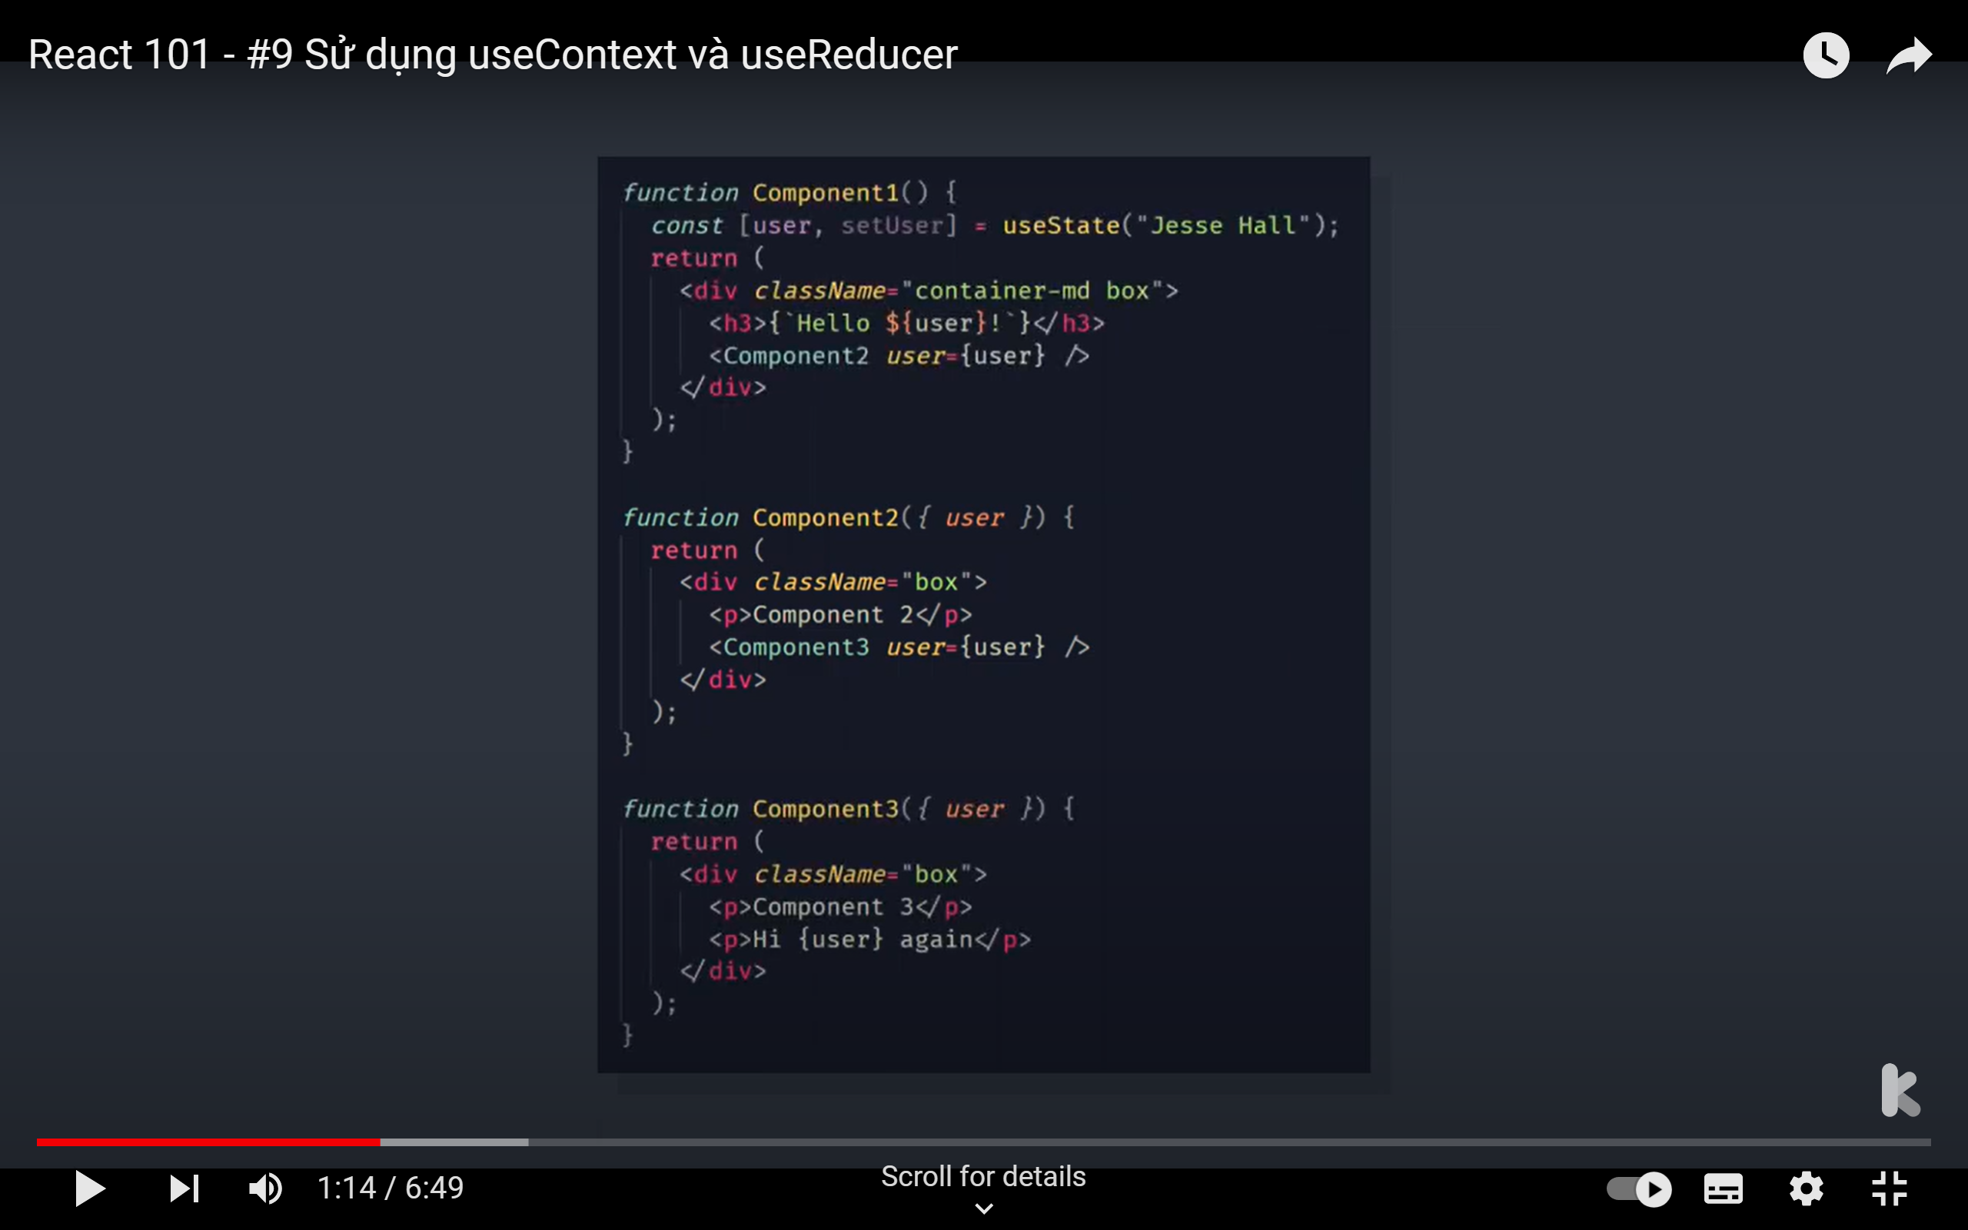

Slide 19
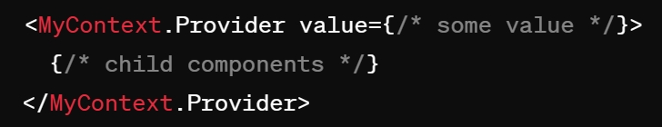
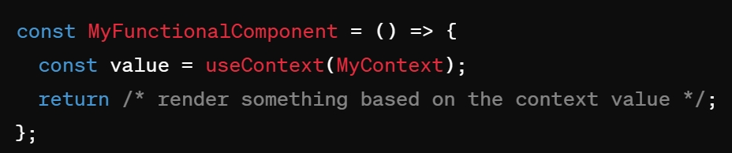
Providing and consuming context
Providing Context
Create a Context
Provide a Context Value
Consuming Context

Slide 20
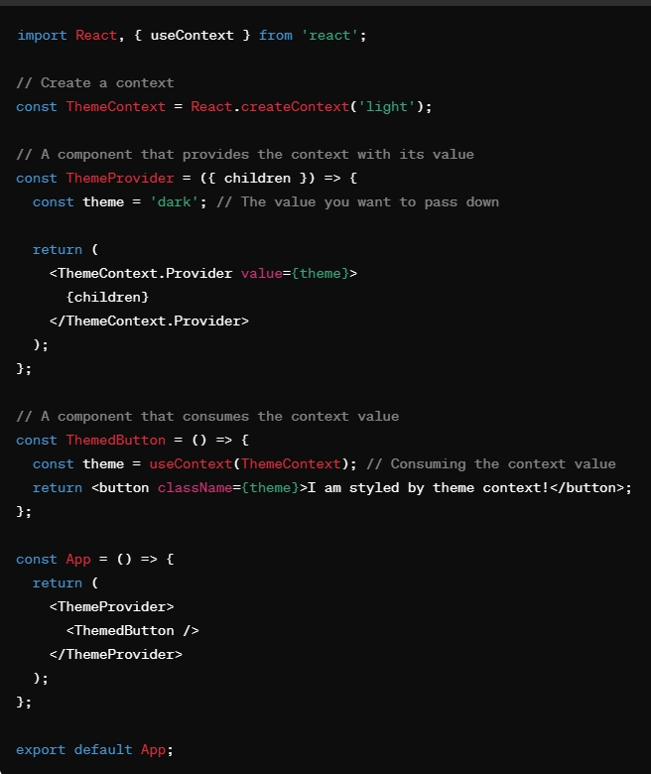
Providing and consuming context – cont’d

Slide 21
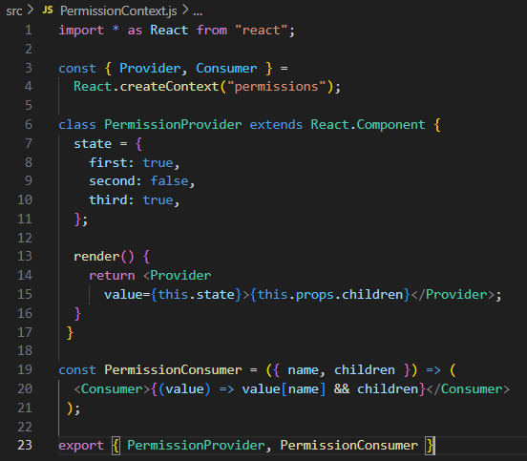
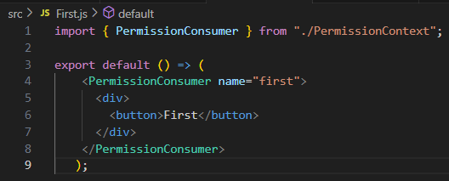
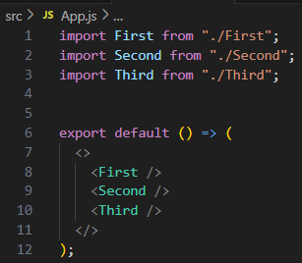
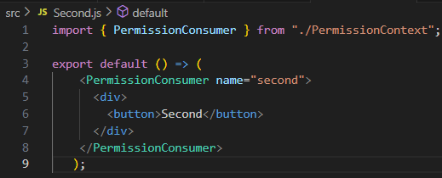
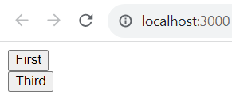
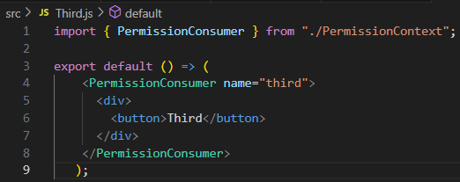
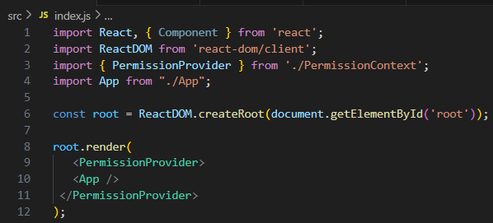
Providing and consuming context – cont’d

Slide 22
Exercise 11: React Component 2

Slide 23
Lab 3: Demo about all Components

Slide 24
Summary
Concepts were introduced:
Passing Property Values
Stateless Components
Container Components
Providing and Consuming Context

